Slide 1
Spatio-Temporal Modeling
Dawood Al Chanti
11 rue des Mathématiques – BP 46
38402 St Martin d’Hères
13/12/2017

Slide 2
Presentation Discussion
Affective Computing
Data Characteristics where this model is applicable.
Spatio-Temporal Analysis
General Model Architecture
Local Spatio-Temporal Modeling through 3D-CNN.
Global Spatio-Temporal Modeling through ConvLSTM.
Providing Invariant Representation.
Classifying Videos or Sequences based on a single label.
2

Slide 3

Affective Computing : Emotional Intelligence (EI) Machines
Application:
Pain detection.
Deception detection.
Fatigue detection.
Danger detection.
Human Machine Interaction
My Interests:
Macro-Spontaneous Emotion Recognition.
Micro-Spontaneous Emotion Detection.
Multi-Modal Model using Bio-Visual Channels like Facial Data + EEG, EMG, ..
‹#›

Slide 4
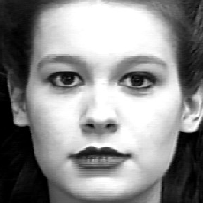
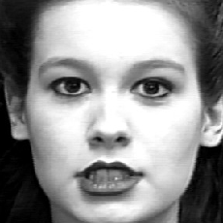
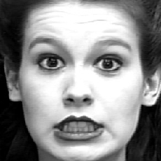
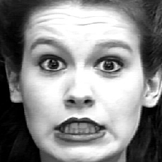
2. Facial Data characteristics in my case
2D
Image
Space
…
Apex
1D
Time
Space
Onset
Offset
Neutral
Neutral
Intensity
t0 ... t10 ... t25 .. t40 .... t60
Intensity
Level
Morphological changes: Evolution of temporal dynamic changes of an expression through time.
Could be Macro changes or Micro changes.
‹#›
Notes:
It allows us to model the Dynamic Temporal Structure in videos
→ Capturing the Morphological Changes in facial expression.
Provide relatively independent representation of events
Events Example: Video contains 4 second Surprised emotion followed by 3 second Angry.

Slide 5
2. Data Characteristics where the following model might be applicable
Sequential Datasets : Videos or Image Sequences.
3-D Volume Datasets: MRI, CT, Images with 3 channels, ...
Temporal Documents
Or any datasets that you can form in 3D shape or in temporal document form.
....
‹#›

Slide 6
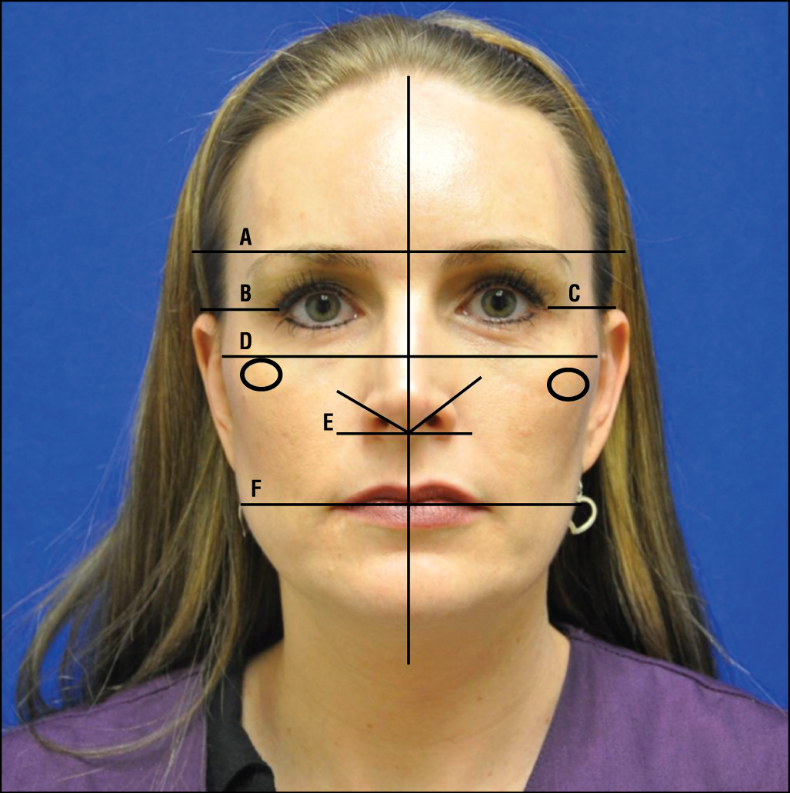
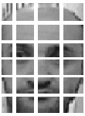
3. Spatial Information
Represented in the Image space 2D
→ It allows us capture features that characterize the shape.
Mainly consists of:
Distance Features
Angular Features
Texture
Edges, ...
‹#›

Slide 7
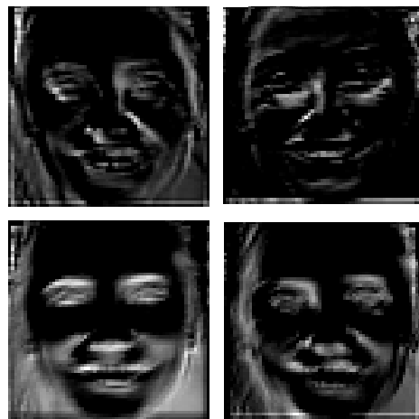
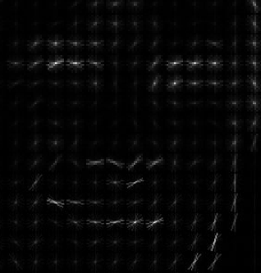
3. Temporal Information
Represented in the time space 1D
→ It capture features that characterize the motion.
Mainly consists of:
Motion
Speed
Duration
Amplitude
Trajectory, ...
‹#›

Slide 8
4. General Model Architecture
E1
Input
Video
3D-CNN
ConvLSTM
Spatial
Pyramid
Pooling
Fully
Connected
Multinomial
Logistic
Classifier
E2
E3
...
En
Extract local spatio-temporal Information to capture subtle and fast local changes.
Extract long term dependencies among the extracted local features to provide semantic representation
Extract multi-scale features
Discover a useful combination to learn a possible non-linear function.
Map into Scores
‹#›

Slide 9
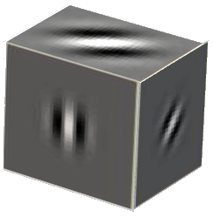
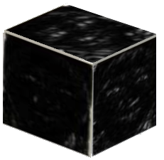
5. Local Spatio-Temporal Feature Extraction
Deep insight into model layer: 3D-CNN
One of the 3D filters of the 1st
3D-Conv-Layer → Gabor Like Filter that capture evolving motion in space and time
Filter Response
‹#›

Slide 10
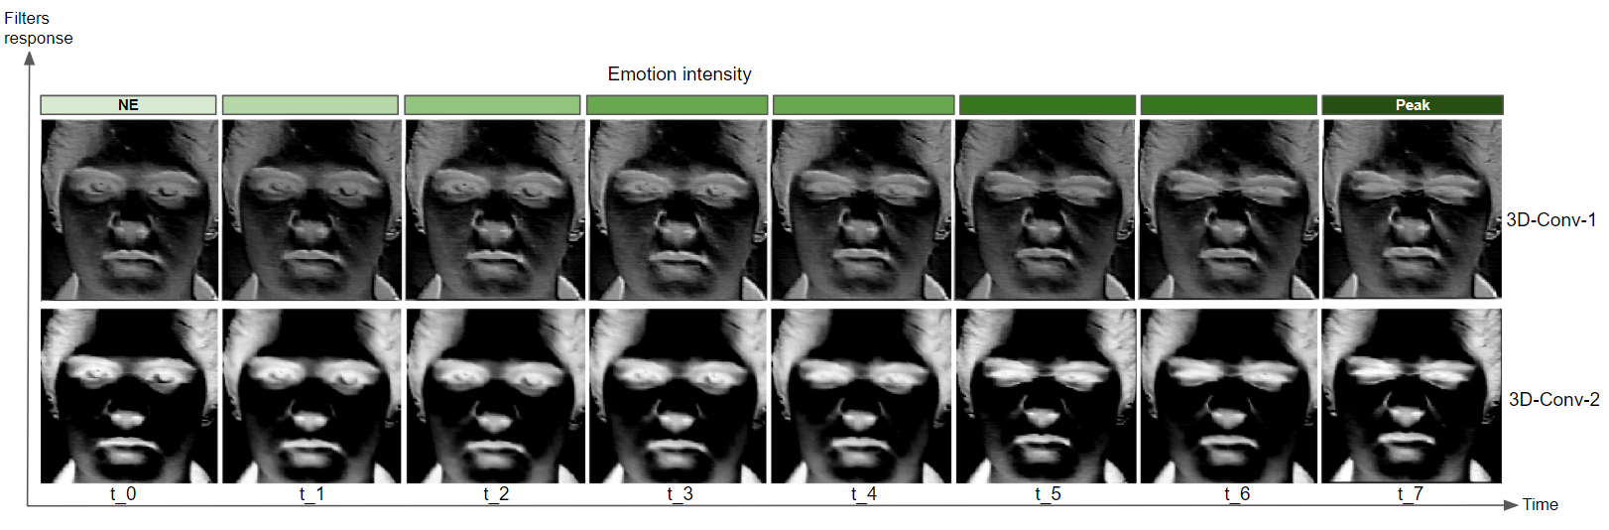
5. Local Spatio-Temporal Feature Extraction
Deep insight into model layer: 3D-CNN
‹#›

Slide 11
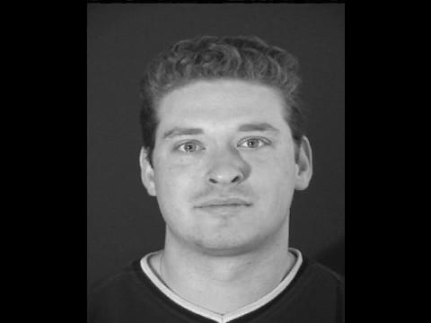
‹#›

Slide 12
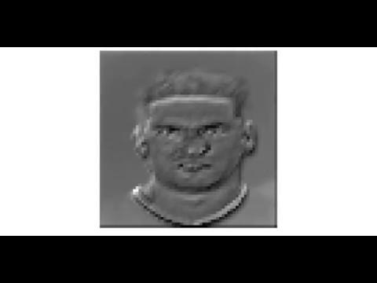
‹#›

Slide 13
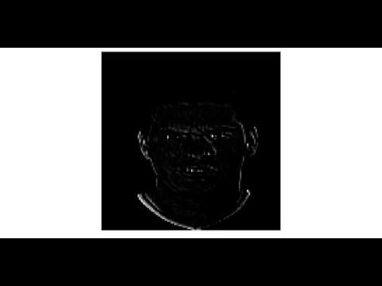
‹#›

Slide 14
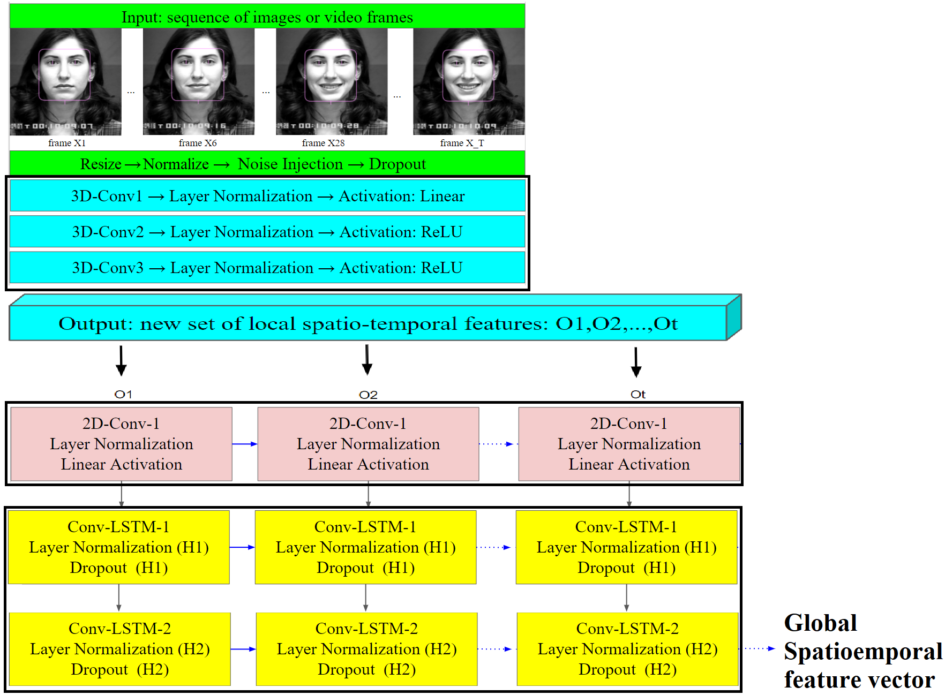
6. Global Spatio-Temporal Feature Extraction
‹#›

Slide 15
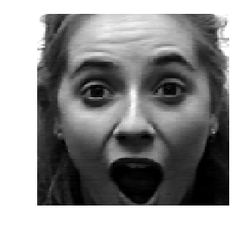
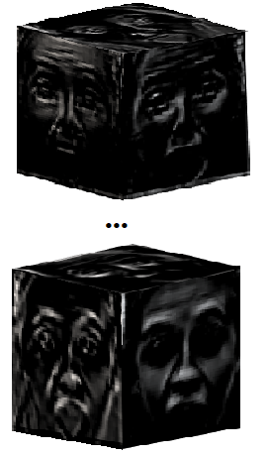
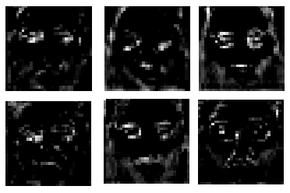
6. Global Spatio-Temporal Feature Extraction
Deep insight into model layer: ConvLSTM
Input Sequence
3D Conv
Feature Maps
ConvLSTM Feature Maps
‹#›

Slide 16
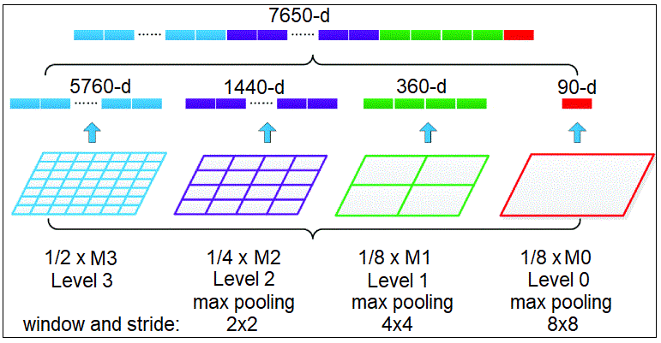
7. Providing Invariant Representation through Spatial Pyramid Pooling SPP-Net
‹#›

Slide 17
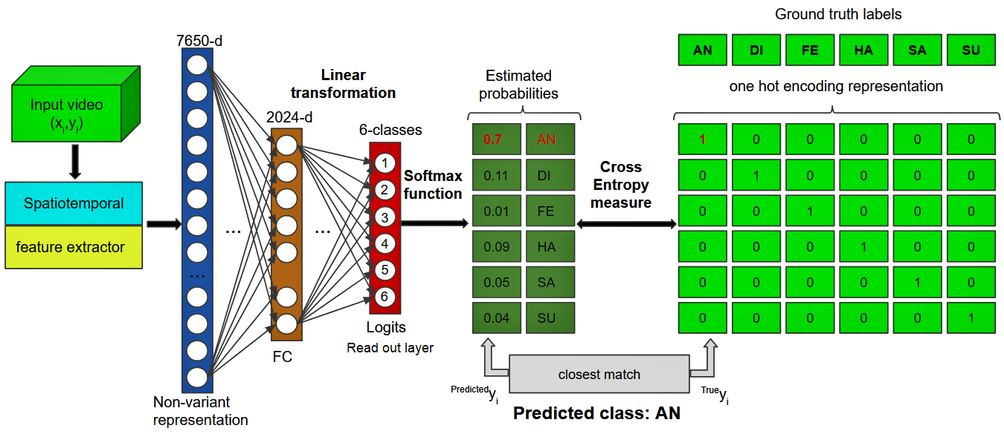
8. Classifying video clips or image sequences based on a single label
‹#›

Slide 18
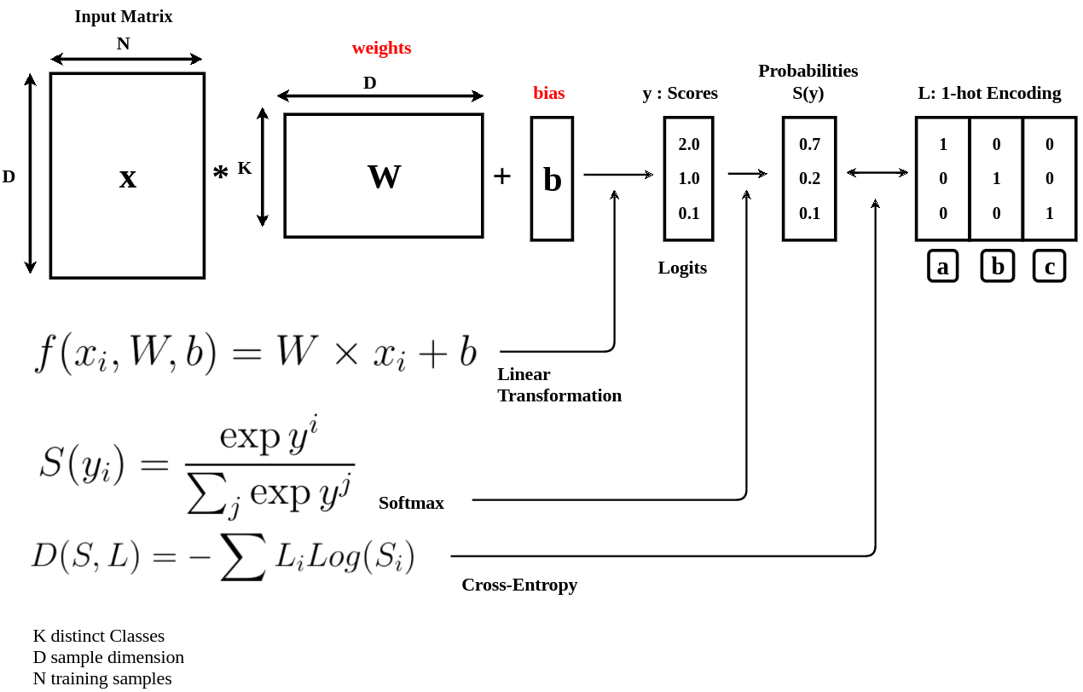
8. Classifying video clips or image sequences based on a single label
Parametrized Mapping from Feature Vector into Labels Using Multinomial Logistic Classifier
‹#›

Slide 19
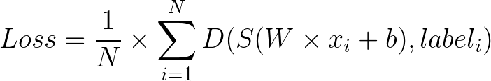
Defining and Minimizing the Objective Function
Linear transformation that maps image pixels into scores or logits
Loss in term of W and b : Parameters
Average over a set of Training Dataset
Distance Measure between two vectors:
Cross Entropy
Softmax : Turn Scores to probability Distribution
‹#›

Slide 20
Remark on :
t-SNE and Hyper-Parameter Tuning and Visualization

Slide 21
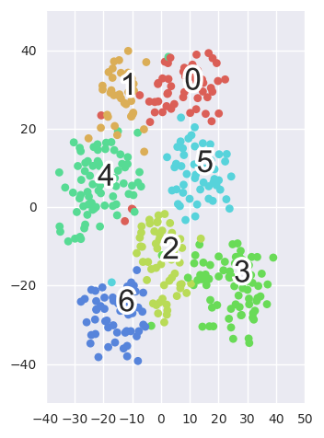
t-Distributed Stochastic Neighbor Embedding for 2D Visualization
Fully
connected
layer
output
feature vector
...
‹#›

Slide 22
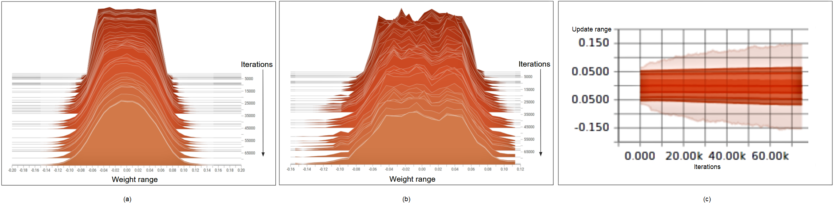
Hyper-Parameter Tuning
‹#›

Slide 23
Thank YOU!!

